Slide 1
Pay Check Potential
Finding some Financial freedom

Slide 2
Why Learn About Money
Money is one place you can visibly see the benefits of good management
This is a place you actually have a few simple but effective tools to help you reach your goals
Unlike career and goal planning the basics are straight forward (although topics like investing can be complex)
Loosing control of your personal finances is obviously less rewarding than retaining control of them

Slide 3
Putting Our Heads Together
Look at garth’s 5 money must do’s
If you think of these rules as things you must achieve, write them in your mini notebook
If you think some of them are not worth the stress to achieve – leave them out
On the whiteboard, put your name beside those you are convinced are “Must Do’s”

Slide 4
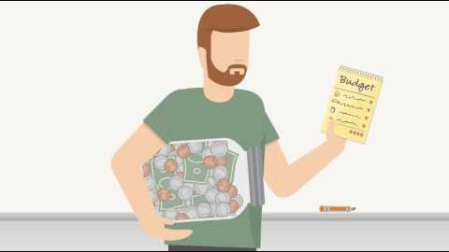
Garth’s Rules Squeezing Potential out of Your Paycheck
Spend Less
than you make
Start an Emergency Account
(prioritize this over spending)
Spending Plan
Plan your spending
Saving Trumps Borrowing
Serve Your Goals
(meaning your 1st payment each money goes to your plans not bills or spending)

Slide 5
Troubling Habits
Spend money to make yourself feel good
Make late or incomplete payments on your debts
Borrow for things that do not hold their value
Compare yourself to others around you
Difficult to avoid this but it is important
Letting money management replace life management
(if you love rebalancing your portfolio and selecting stocks than take the time, if not, create a simpler system.)

