Slide 1
Healthy Eating

Slide 2
When it comes to nutrition, the habits we develop as young people will likely stay with us throughout our lives. Even small changes we make to our eating and drinking habits can have a huge impact on our health and the way we feel now and in the long-run.

Slide 3
Activity
What did you eat / drink in the past 2 days?
Breakfast x2
Lunch x2
Supper x2
Snacks
Beverages

Slide 4
Skipping Meals
Breakfast
* leads to overeating later in the day
* lowers energy
* causes tiredness and distractibility
Lunch
* may cause headaches, tiredness and overeating later in the day
* craving for junk food

Slide 5
Three Main Nutrients
Carbohydrates
Proteins
Healthy Fats

Slide 6
Carbohydrates
Provide fuel for our brains and muscles
Contain important vitamins, minerals, fiber, antioxidants, and phytochemicals which help prevent disease
Fruits , vegetables, whole grains

Slide 7
Proteins
Provides building blocks for bones, muscles, cartilage, skin and blood
Are used to make important enzymes, hormones and vitamins
Helps normalize blood sugars, makes us feel alert and provides a feeling of fullness
Meat, beans, soy products, nuts, dairy products

Slide 8
Healthy Fats
Provide energy and essential fatty acids which help keep our skin healthy, help absorb certain vitamins, and play a key role in brain development
Consume monounsaturated and polyunsaturated fats and omega-3 fatty acids (avocados, olives, nuts, fish and “healthy oils”
May reduce heart disease and lower blood pressure
Avoid trans fats, saturated fats and hydrogenated fats

Slide 9
Activity –Reading Food Labels
Serving size
# of Calories per serving
Look for ingredients you are trying to avoid – saturated fats, trans fats, cholesterol & sodium & the % of daily value
Look for ingredients you want & the % of daily value
Labels often include – carbohydrates, fiber, total fat, cholesterol, sodium, vitamins & minerals
Ingredients –list from highest to lowest
Sugar and sodium may be listed multiple times with different names
IF YOU DON’T RECOGINIZE THE INGREDIENT AS A FOOD – IT PROBABLY ISNT SOMETHING YOU SHOULD EAT A LOT OF

Slide 10
Tips for Eating More Fruits & Vegetables
Add vegetables to the mix when you cook – spinach, broccoli, peppers or peas to your pasta, soup or stir fry
Eat fruits & veggies as a snack
Eat a variety –dark green ( broccoli, kale, spinach), starchy (peas, potatoes, corn), red & orange (tomatoes, carrots, peppers)
Eat seasonal fruits & veggies
Buy veggies that are easy to prepare

Slide 11
The Benefits of a Brain Healthy Diet
better mood stability
stronger focus
less distractibility
fewer cravings for sugary snacks
less tiredness in the late morning \ early afternoon

Slide 12
9 Foods to Eat (and avoid) For Brain Healthy Eating
Quality over Quantity - Focus on high quality calories which positively impact the way the brain works. Good healthy food is brain medicine. It can have a powerful positive effect on cognition, feelings and behavior.
Water - Your brain is 80% water. Staying hydrated by drinking lots of water throughout the day but avoiding sugary drinks and juice.
Protein - start each day with protein to boost focus and concentration. Examples of great sources of protein include eggs, chicken, beans, nuts, fish, vegetables (broccoli, peas, kale, spinach, mushrooms, etc.) Protein helps balance your blood sugar, increases focus, and gives your brain the necessary building blocks for brain health.

Slide 13
4. Go with low-glycemic/high fiber carbs - eat carbohydrates that do not spike your blood sugar and that are high in fiber such as vegetables, legumes, fruits (i.e. blueberries, apples )~ eating a diet that is filled with low glycemic foods will lower blood glucose levels, decrease cravings and help with focus.
5. Go with Good Fats - Good fats are essential to your health. The solid weight of your brain is 60% fat(after all the water is removed)
Healthy fats (especially those that contain Omega 3 Fatty Acids) – salmon, sardines, avocado, walnuts, chia seeds, dark green leafy vegetables, etc.
You can supplement with fish oil (which contains Omega 3) or a seed oil (which contains Omega 3 and Omega 6 fats)

Slide 14
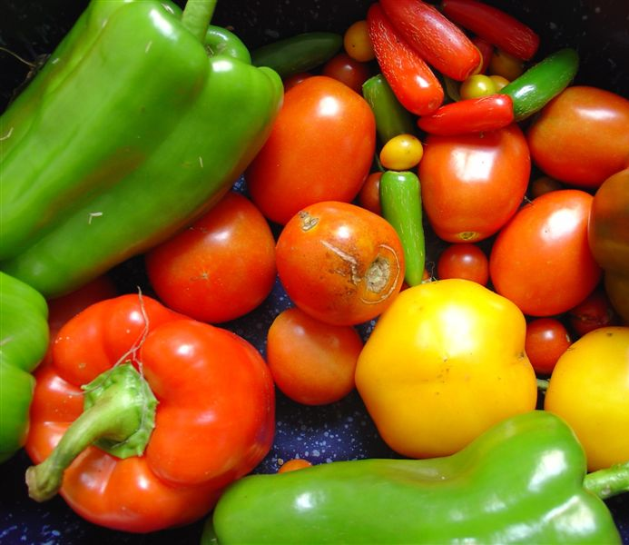
6. Eat foods that reflect the colour of the rainbow such as blueberries, pomegranates, yellow squash, red bell peppers, etc. They boost the antioxidant levels in your body and keep your brain healthy.
7. Use different herbs and spices that can have healthy affects on the brain.
8.Try to eliminate or reduce food additives, preservatives, artificial dyes and sweeteners.

Slide 15
9. Be aware of possible food sensitivities/intolerances. Most common foods that may be a problem are: wheat, other gluten containing grains (barley, rye, spelt, etc.), dairy, soy, corn, eggs.

Slide 16
Healthy Snack Choices
Carrots & celery with hummus
Fruit
Popcorn
Cheese & whole grain crackers
Rice cakes with peanut butter
Trail mix
Smoothie

Slide 17
Sleep Strategies that may be helpful:
Creating a calm and structured bedtime routine.
Shutting down electronics, T.V., video games, and other stimulating activities at least 1 hour before bed.
the light emitted from electronics can delay the release of the sleep inducing hormone melatonin. Electronics also overstimulate the brain making it much more difficult to fall asleep.
engaging in calming activities such as reading, mindfulness activities, deep breathing, relaxing music, etc.
Start a bedtime routine 30-60 minutes before bed
Set up a realistic time for bed and stick to that schedule.
Pay attention to the room environment i.e. dark, quiet, cool, white noise etc.

Slide 18
Get plenty of exercise
Monitor eating times – sometimes eating heavily too close to bedtime can inhibit a good nights sleep. Also, sugary snacks can negatively impact sleep.

Slide 19
Activity – Choose Recipes
Choose 4/5 recipes that meet the following criteria:
Nutritious
Can accommodate any allergies \ intolerances (within the group)
Feed 10 people
Can be prepared in 90 minutes
Fit within the budget

